Slide 1

Predicting the Demand In Bike Sharing Stations based on Station’s Characteristics Case study: Los Angeles, California
Nadya Rizki Fadilah
Urban and Regional Planning, Institut Teknologi Bandung

Slide 2
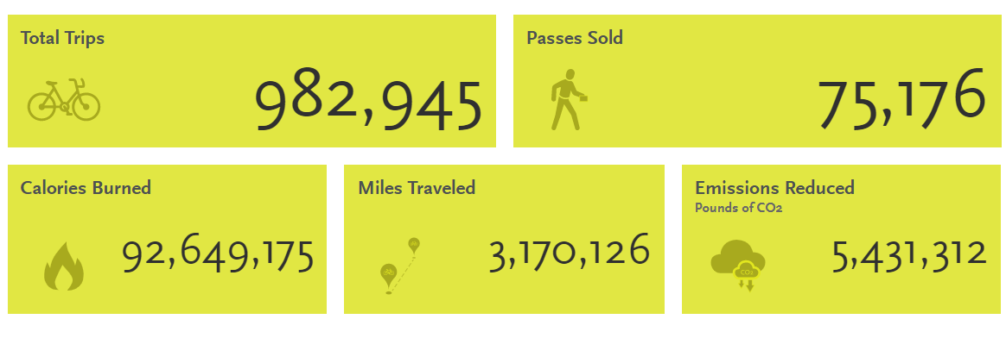
Los Angeles Metro Bike Share
Bike sharing is defined as the shared use of a bicycle, in which a user accesses a fleet of bicycles offered on public space. Metro Bike Share is a partnership between Metro and the City of Los Angeles.. The Metro Bike Share system makes bikes available 24/7, 365 days a year in Downtown LA, Central LA, North Hollywood and the Westside.

Slide 3
Project Purpose:
Project Rationale:
Growing trends of bike sharing can be attributed to its associated social, economic, and environmental benefits, among others. These are related to creating a larger cycling population, increasing transit use, reducing greenhouse gases, decreasing congestion, creating environmental awareness, and improving public health, amongst other
People mobility patterns are heavily influenced by the built environment surrounding it; the availability of infrastructures, the activities and density of the area.
It is important for the transit authority and planners in general to be able to predict the potential demand before investing in the infrastructure.
By knowing the significant factors that affect the station’s ridership, the public authority will be able to determine which investment needed to improve the ridership.
Predicting the potential ride demand based on the characteristic of the station’s location.

Slide 4
What affects its ridership?
Previous studies:
Reference | Cities | Method Used | Variables Inspected
Duran-Rodas et. al. (2019) | Multiple Cities | GBM with Logarithmic Transformation OLS with Logarithmic Transformation | City population Distance to city centers Distance to bakeries, college, cinemas, etc
Yi He et.al. (2019) | Park City, Utah | Poisson Regression | Higher daily temperature Lower wind speed Distance to public transit center Bike infrastructure Higher density
Scott & Ciuro (2019) | Hamilton | Linear Regression with logarithmic transformation | Precipitation Weekday/Weekend minor and major roads number of additional bike share hubs Number of bus lane Bike lanes

Slide 5
Independent Variables & Data Sources Used:
Trips Data:
Trips data of all operating stations in 2019
Weather Data
Temperature
Precipitation (source: https://www.ncdc.noaa.gov/)
Characteristic of Station’s Area:
Walking Score: Measures walkability on a scale from 0 - 100 based on walking routes to destinations such as grocery stores, schools, parks, restaurants, and retail. Source: https://www.walkscore.com/
Transit Score: Measures transit accessibility on a scale from 0 - 100. Calculates distance to closest stop on each route, analyzes route frequency and type. Source: https://www.walkscore.com/
Measures bike accessibility on a scale from 0 - 100 based on bike infrastructure, topography, destinations and road connectivity. Source: https://www.walkscore.com/
Distance of each station to its region center

Slide 6
Method:
Linear Regression
Linear regression is a linear approach to modeling the relationship between a scalar response (or dependent variable) and one or more explanatory variables (or independent variables).
Gradient Boosting Regressor
Gradient Boosting is a tree based method of converting weak learners into strong learners. In boosting, each new tree is a fit on a modified version of the original data set.
Random Forest Regressor
Random Forest is a tree based method that use multiple independent trees to achieve the best prediction

Slide 7
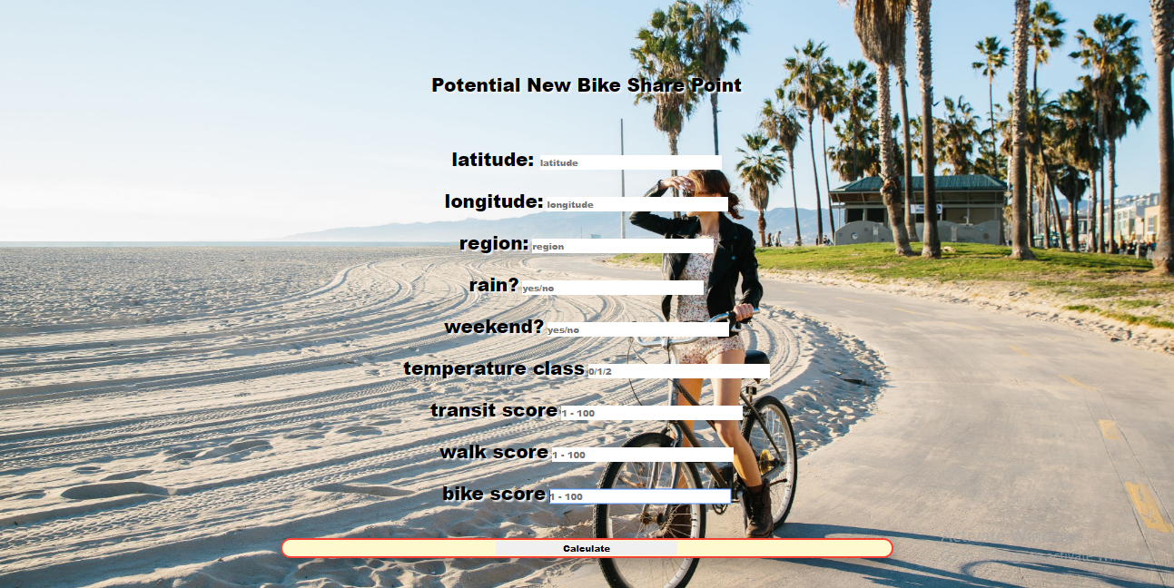
Example how it can be used: (homepage)

Slide 8
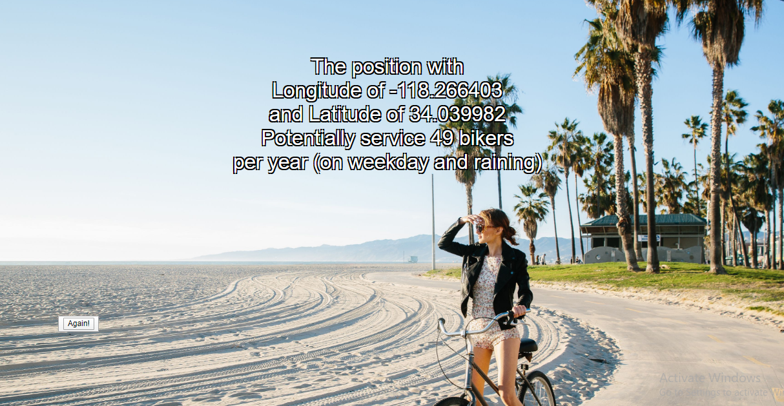
Example how it can be used: (result)

Slide 9
Reference:
Duran-Rodas, D., Chaniotakis, E., & Antoniou, C. (2019). Built Environment Factors Affecting Bike Sharing Ridership: Data-Driven Approach for Multiple Cities. Transportation Research Record: Journal of the Transportation Research Board, 2673(12), 55–68. doi: 10.1177/0361198119849908
He, Y., Song, Z., Liu, Z., & Sze, N. N. (2019). Factors Influencing Electric Bike Share Ridership: Analysis of Park City, Utah. Transportation Research Record: Journal of the Transportation Research Board, 2673(5), 12–22. doi: 10.1177/0361198119838981
Scott, D. M., & Ciuro, C. (2019). What factors influence bike share ridership? An investigation of Hamilton, Ontario’s bike share hubs. Travel Behaviour and Society, 16, 50–58. doi: 10.1016/j.tbs.2019.04.003

